Slide 1

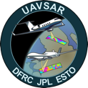
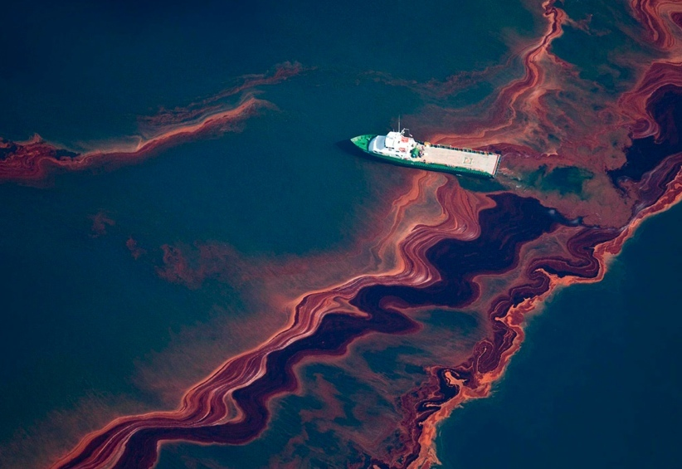
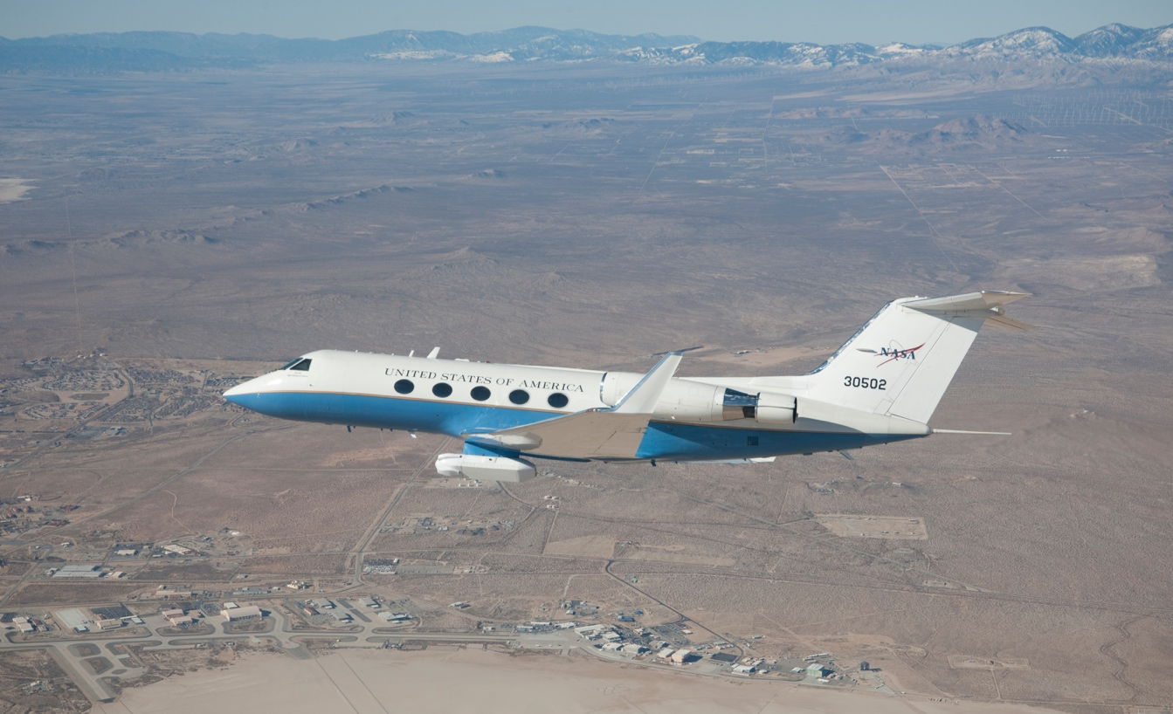
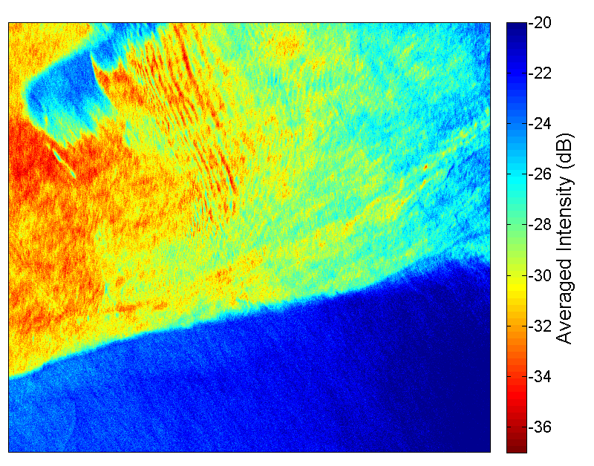
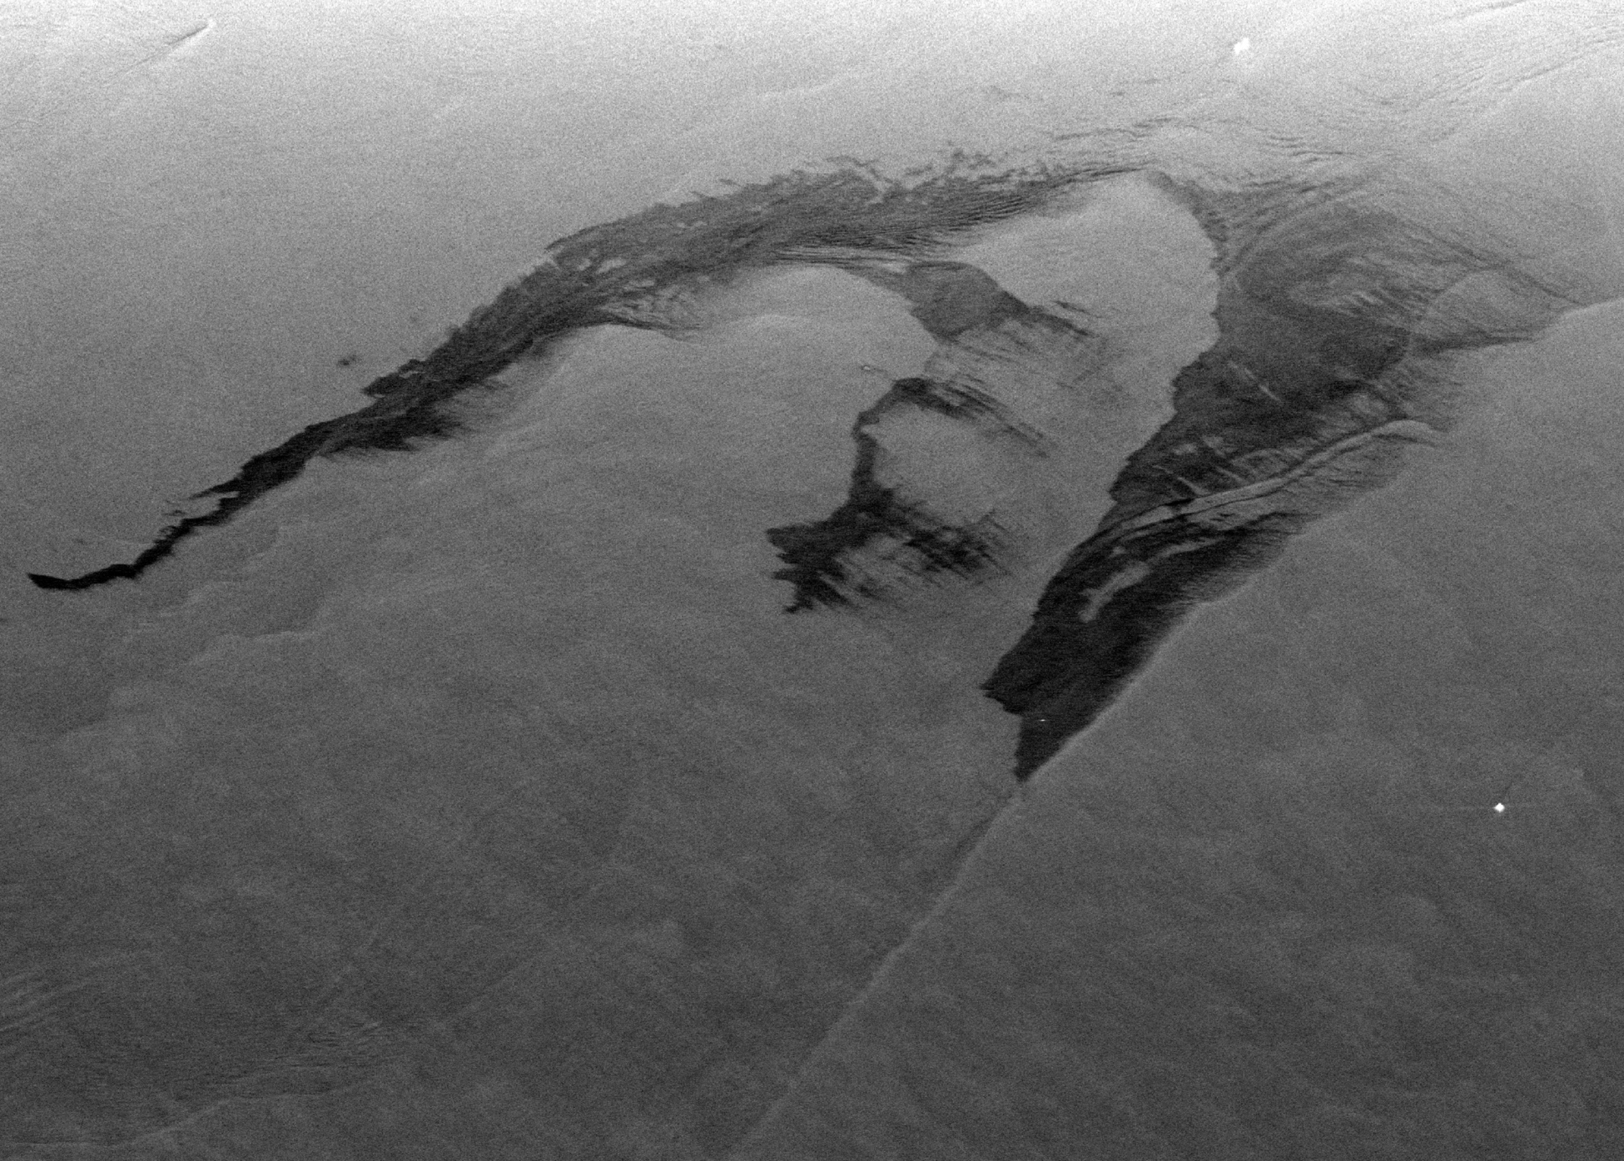
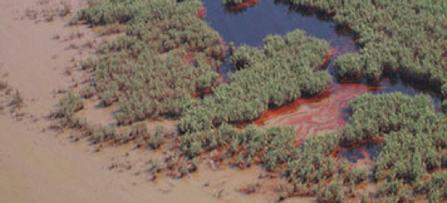
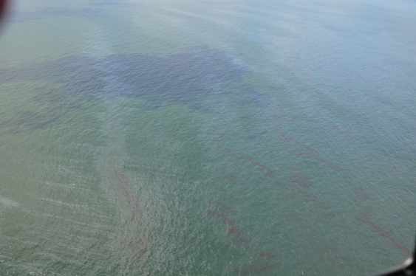
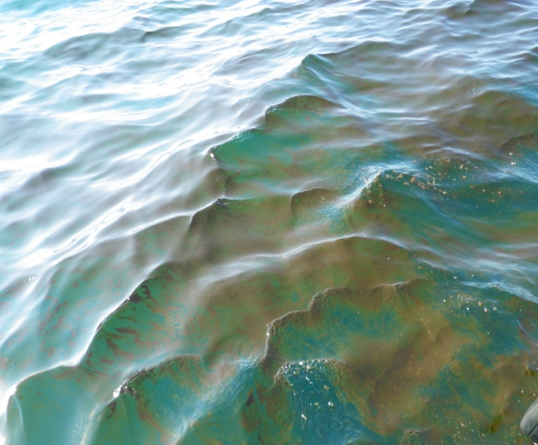
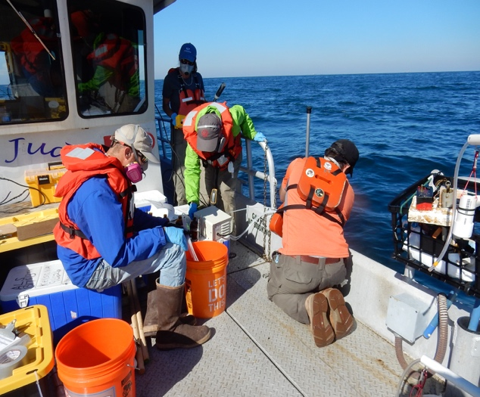

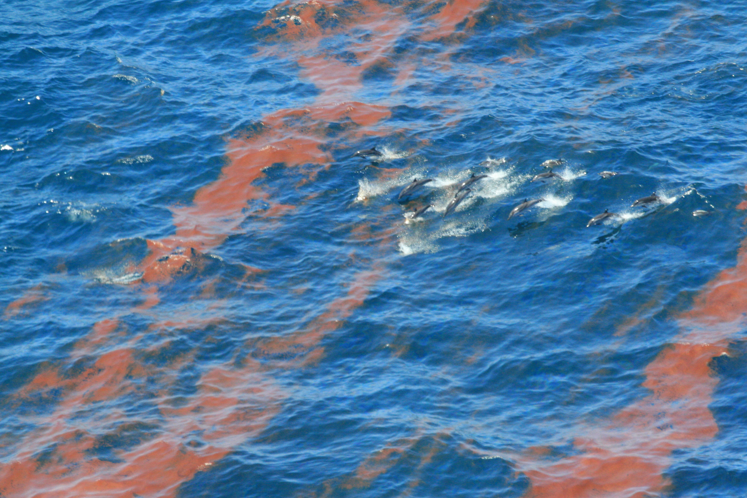
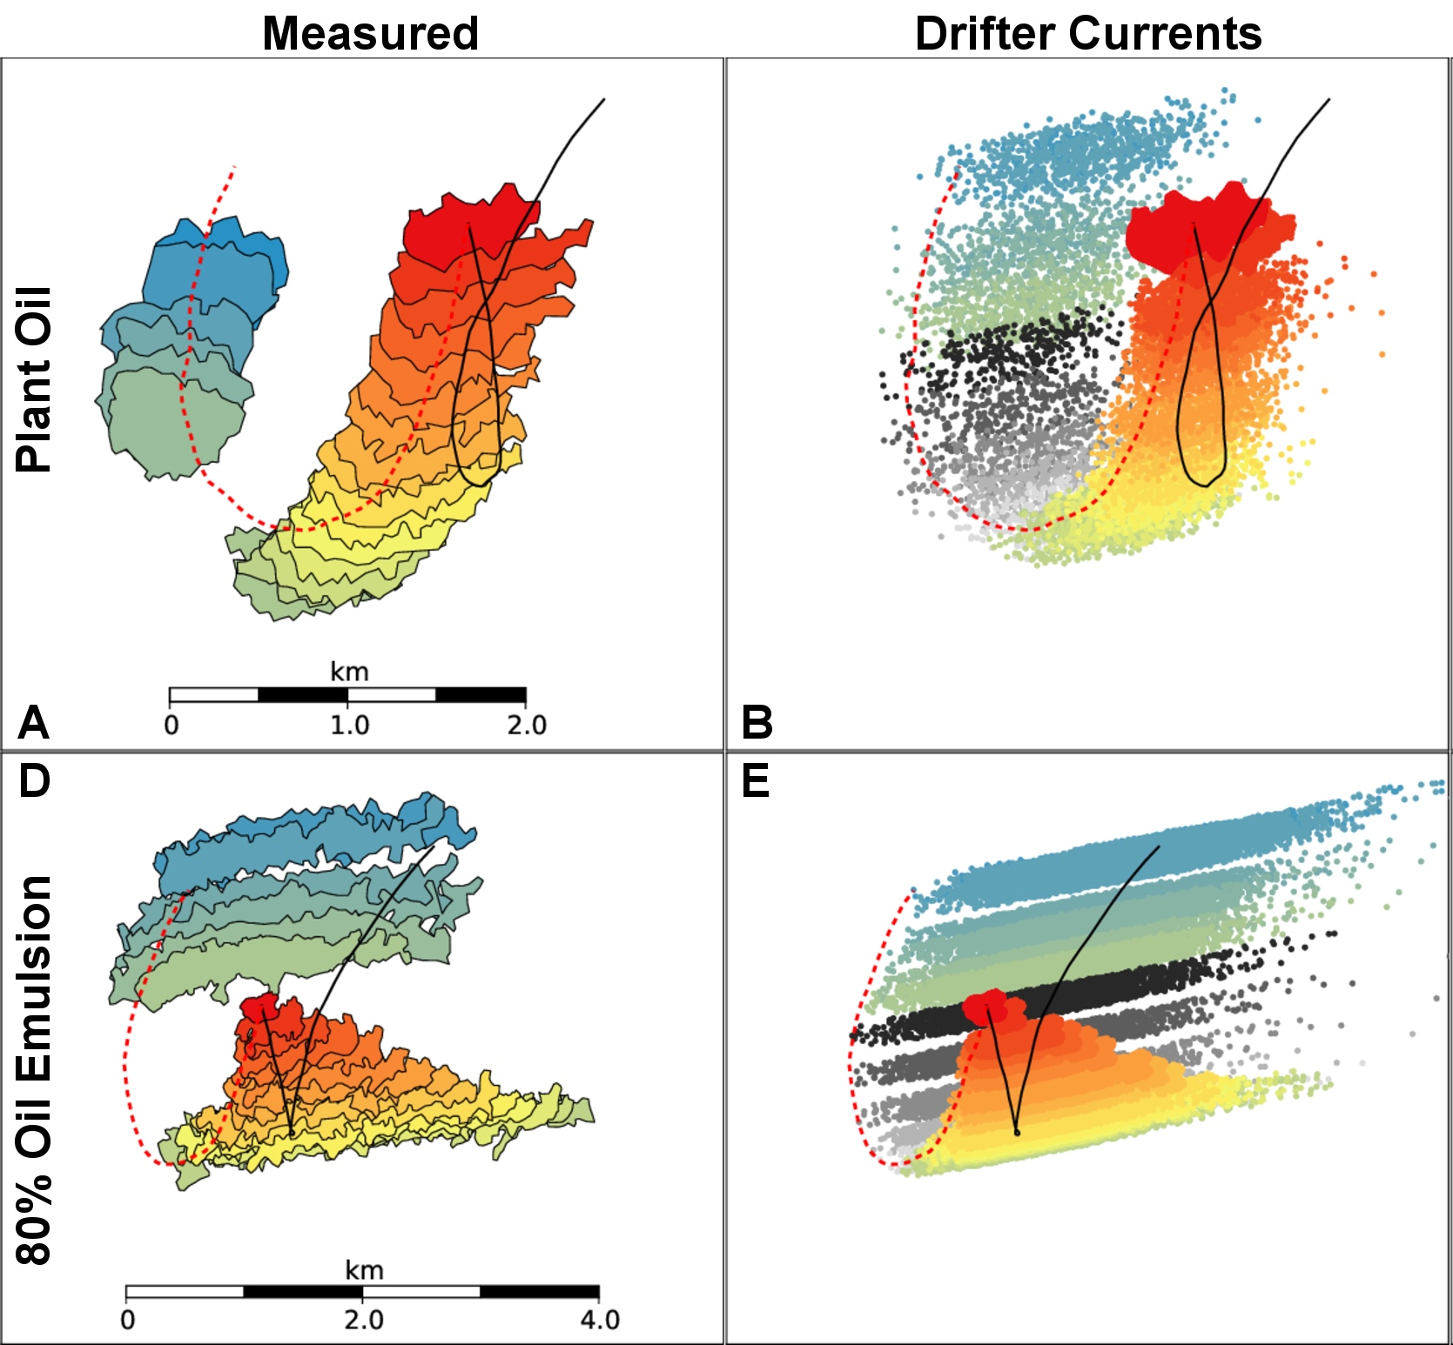
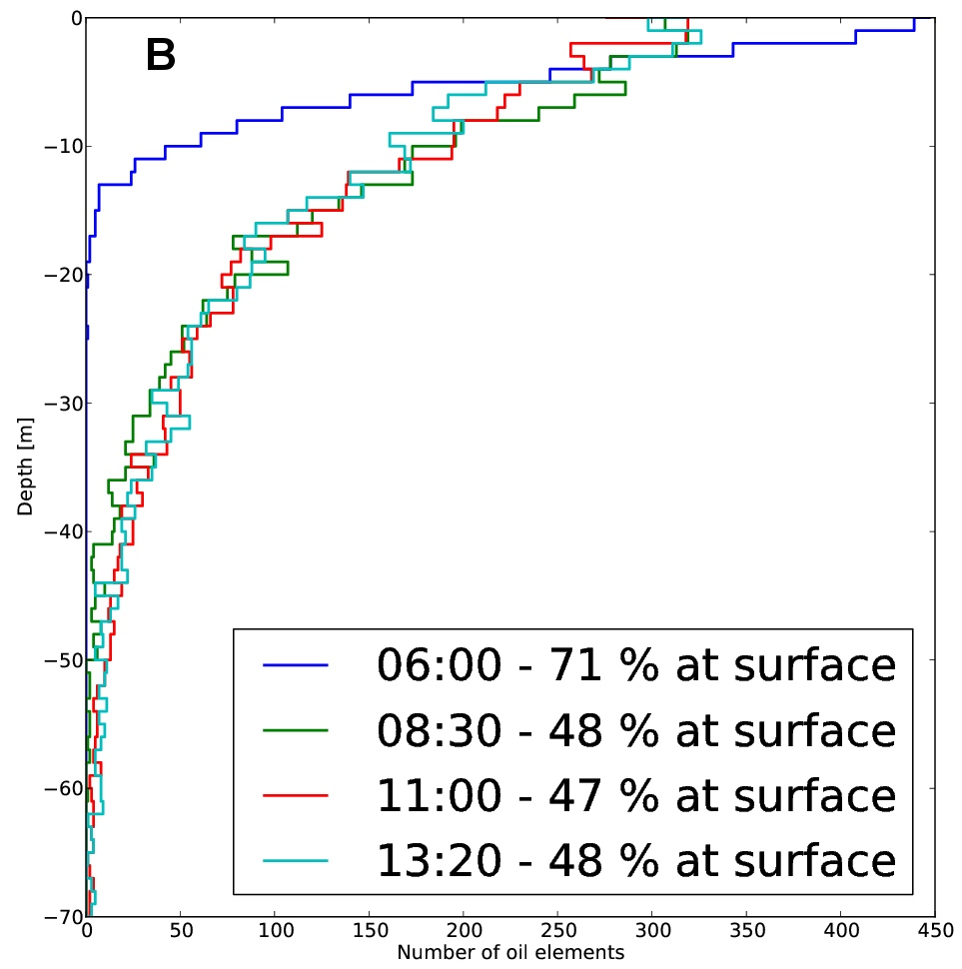
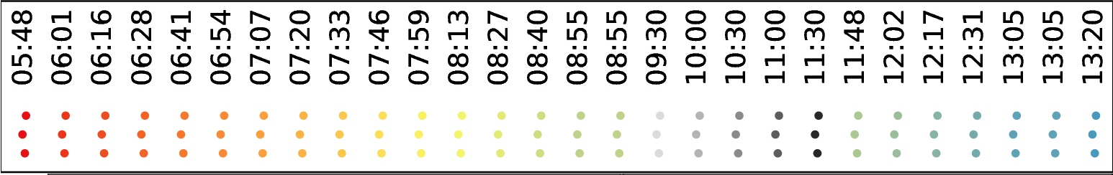
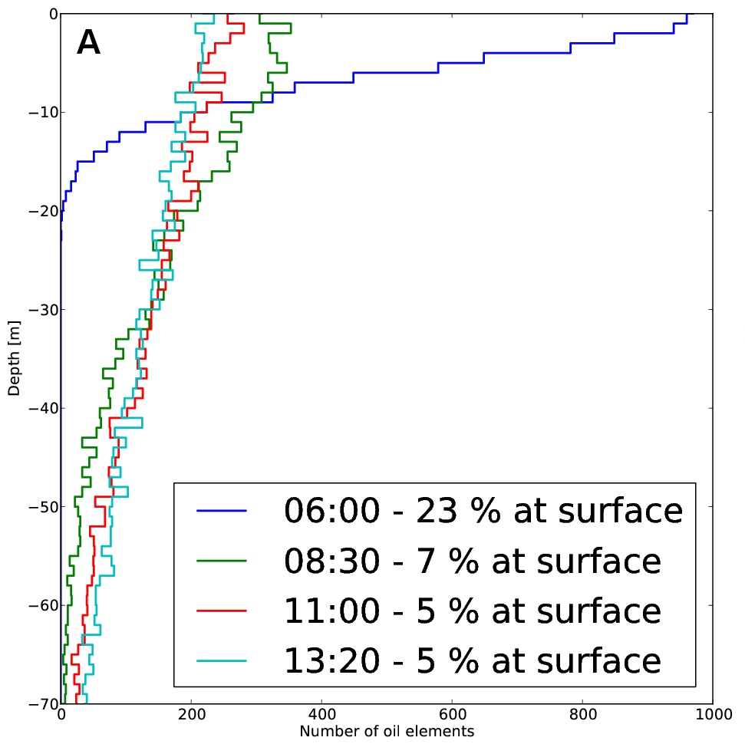





Oil Slick Characterization with UAVSAR
Cathleen E. Jones, Benjamin Holt
Jet Propulsion Laboratory, California Institute of Technology
AGU Fall 2017, Session 27022
Abstract ID: 254026
Parameter | Value
Center Frequency | L-Band @ 1.257 GHz
Bandwidth | 80 MHz
Intrinsic Resolution | 1.8 m Slant Range, 0.8 m Azimuth
Polarization | Full Quad-Polarization
Antenna Aperture | 0.5 m range/1.5 m azimuth
Azimuth Steering | Greater than ±20
Transmit Power | > 3.1 kW
Nominal Spatial Posting | 6 m
Range Swath | 22 km
Look Angle Range | 25º - 65º
Noise Equivalent σº | < -34 dB
Radiometric Accuracy | < 1 dB relative, 2 dB absolute
UAVSAR Instrument characteristics
Airborne Synthetic Aperture Radar’S Advantages for Oil Spill Response and Assessment
Complex Permittivity
ε = ε' – iε''
Sea water ε_{sw} = 80 –i70
-High conductivity surface
Crude oil ε_{O} = 2.3 –i0.02
-Low conductivity surface
Airborne instruments can have significantly higher power than satellite SARs, yielding much higher signal-to-noise ratio.
Extremely low noise instrument enables measuring radar-dark oil slick characteristics
Rapid repeat observations (up to 4 per hour) enable tracking of changes in slick location and extent
Ocean Surface (no oil)
ε_{SW} = 80 –i70
-Frequency, temperature
dependent
Characterization Of Oil Within Slicks Using SAR
Ocean Surface
+Thin Sheen
Sheen
-Reduced roughness
-Sheen too thin to
change ε_{sw}
Emulsion =
Mixture of Oil
+ Sea water
ε_{SW+Sheen} ~~ 80 –i70
-New dielectric layer
with ε mixture
–Alters scattering
Emulsion
Radar
ε_{Mixture} = ε_{SW} + ε_{O}
Radar backscattered signal responds to volumetric fraction of emulsified oil as a mixture of oil and seawater
2010: Deepwater Horizon Oil Spill,
Gulf of Mexico
2016: NOAA Oil slick study, Taylor Energy Seep, Gulf of Mexico
UAVSAR’S Unique Contribution: First quantitative measurement of oil:water volumetric fraction within a slick using SAR [Minchew et al., 2012]
UAVSAR’S Unique Contribution: Fine spatial resolution map of relative oil thickness derived from contrast between slick and clean water using VV-polarization returns.
Oil concentrated along wind rows:
Deepwater Horizon Spill, 2010
Gulf Ecosystem Impact & Recovery, 2010-2012
Transport path
Covered main slick & Gulf coastline
2 days, 3 flights, 21 flight hours
Imaged an area of 120,000 km²
Repeated yearly observations
Focused on heavily oiled marshlands
Track long-term ecosystem response
UAVSAR image of the Taylor Energy Slick
(VV-polarization)
wind
N
Gulf of Mexico NOAA Experiment, 2016
Norwegian Oil-on-Water Exercise, 2015
Photos taken over the slick on 6/23/2010 between 16:00 and 20:00 UTC (NOAA RAT-Helo and EPA/ASPECT)
Engage with U.S. response & recovery
Measure release from an abandoned rig
Measure extent, relative thickness, volume, weathering
Controlled experiment
Release known volumes & mixtures
Measure & model 3-D slick transport
~20 km
2015: Norwegian oil-on-water exercise, North Sea
Oil classification – relative thickness like the Bonn classification
Based on the VV damping ratio
UAVSAR’S Unique Contribution: Tracking the spreading and transport of different mineral oil slicks & a plant oil slick enabled improved modeling of oil transport in the ocean, both on the surface & in the water column [Jones et al., 2016].
Effective oil spill response requires specific information about the slick’s characteristics:
Key Parameters:
Spill position
Extent
Transport (3D)
Thickness & volume
Oil-to-water ratio
Weathering
Slick type (mineral vs. look-alike)
SAR is routinely used for this
80% OIL EMULSION
Slowly entrains
Most oil stays at surface
Stronger wind-driven transport
Transport & Weathering
(shows the oil that was on surface for the longest time)
New SAR-based capabilities being studied & developed with UAVSAR
1
3
Simulation Start Time: 05:48
References:
Jones, C. E., K.-F. Dagestad, O. Breivik, B. Holt, J. Rohrs, K. H. Christensen, M. Espeseth, C. Brekke, S. Skrunes (2016). Measurement and modeling of oil slick transport, J. Geophysical Res.-Oceans, 121, 7759-7775, doi:10.1002/2016JC012113.
Skrunes, S., Brekke, C., Jones, C., and Holt, B. (2015). A multisensor comparison of experimental oil spills in polarimetric SAR, IEEE Journal of Selected Topics in Applied Earth Observations and Remote Sensing, doi:10.1109/JSTARS.2016.2565063
Latini, D., Del Frate, F., Jones, C. E. (2016). Multi-frequency and polarimetric quantitative analysis of the Gulf of Mexico oil spill event comparing different SAR systems. Remote Sensing of Environment, 183, 26-42, doi:10.1016/j.rse.2016.05.014.
Fore, A. G., Chapman, B. D., Hawkins, B. P., Hensley, S., Jones, C. E., Michel, T. R., & Muellerschoen, R. J. (2015). UAVSAR Polarimetric Calibration. IEEE Transactions on Geoscience and Remote Sensing, 53(6), 3481-3491.
Minchew, B., Jones, C. E., & Holt, B. (2012). Polarimetric analysis of backscatter from the Deepwater Horizon oil spill using L-band synthetic aperture radar. Geoscience and Remote Sensing, IEEE Transactions on, 50(10), 3812-3830.
Jones, C. E., Minchew, B., Holt, B., & Hensley, S. (2011). Studies of the Deepwater Horizon oil spill with the UAVSAR radar. In Y. Liu et al. (Eds), Monitoring and Modeling the Deepwater Horizon Oil Spill: A Record-Breaking Enterprise (Geophys. Monogr. Ser., Vol. 195, pp. 33-50). Washington D. C.: American Geophysical Union.
2
4
PLANT OIL
Rapidly entrains
Most oil stays below surface
Reservoir of resurfacing oil
Less wind-driven transport
This work was carried out in part at the Jet Propulsion Laboratory, California Institute of Technology, under a contract with NASA.
© 2017 California Institute of Technology. Government sponsorship acknowledged

